Slide 1
9 Year Experience in the field
of Child Abuse and Violence
in South Korea
Un-Sun Chung, M.D., Ph.D.
Kyungpook National University Hospital,
School Mental Health Resources and research Center
(SMHRC)
Notes:
센터로고와 교육부 로고를 타이틀 밑에 붙여주세요

Slide 2
Assistant Professor
School of Medicine
Kyungpook National University,
Department of
Child and Adolescent Psychiatry
Kyungpook National University Hospital
Chilgok Kyungpook Medical Center
Daegu, South Korea

Slide 3
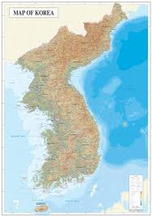

Slide 4
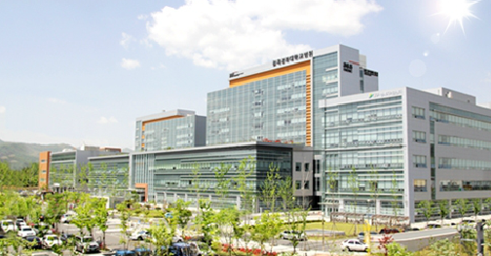
Chilgok Kyungpook Medical Center, Daegu

Slide 13
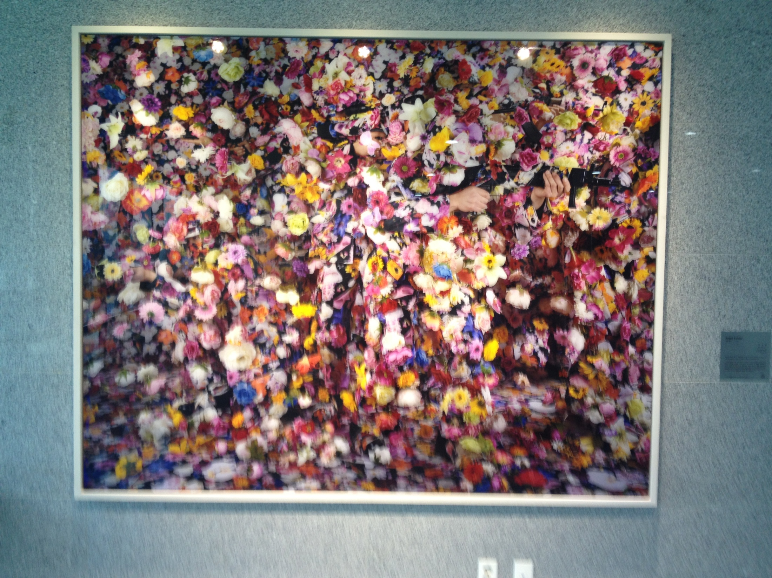

Slide 14
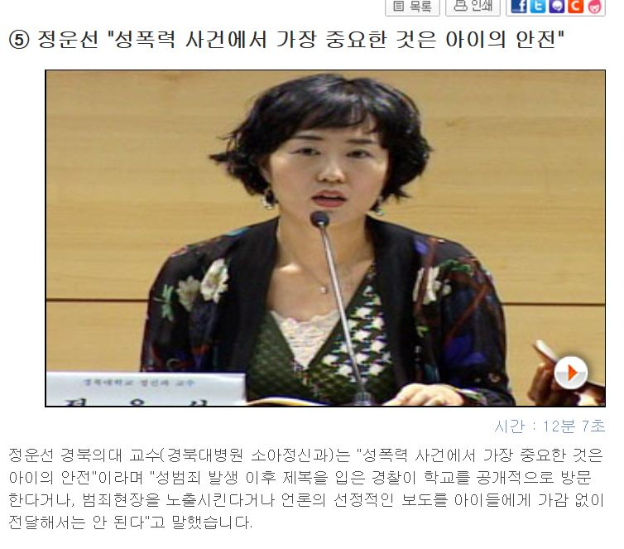

Slide 15
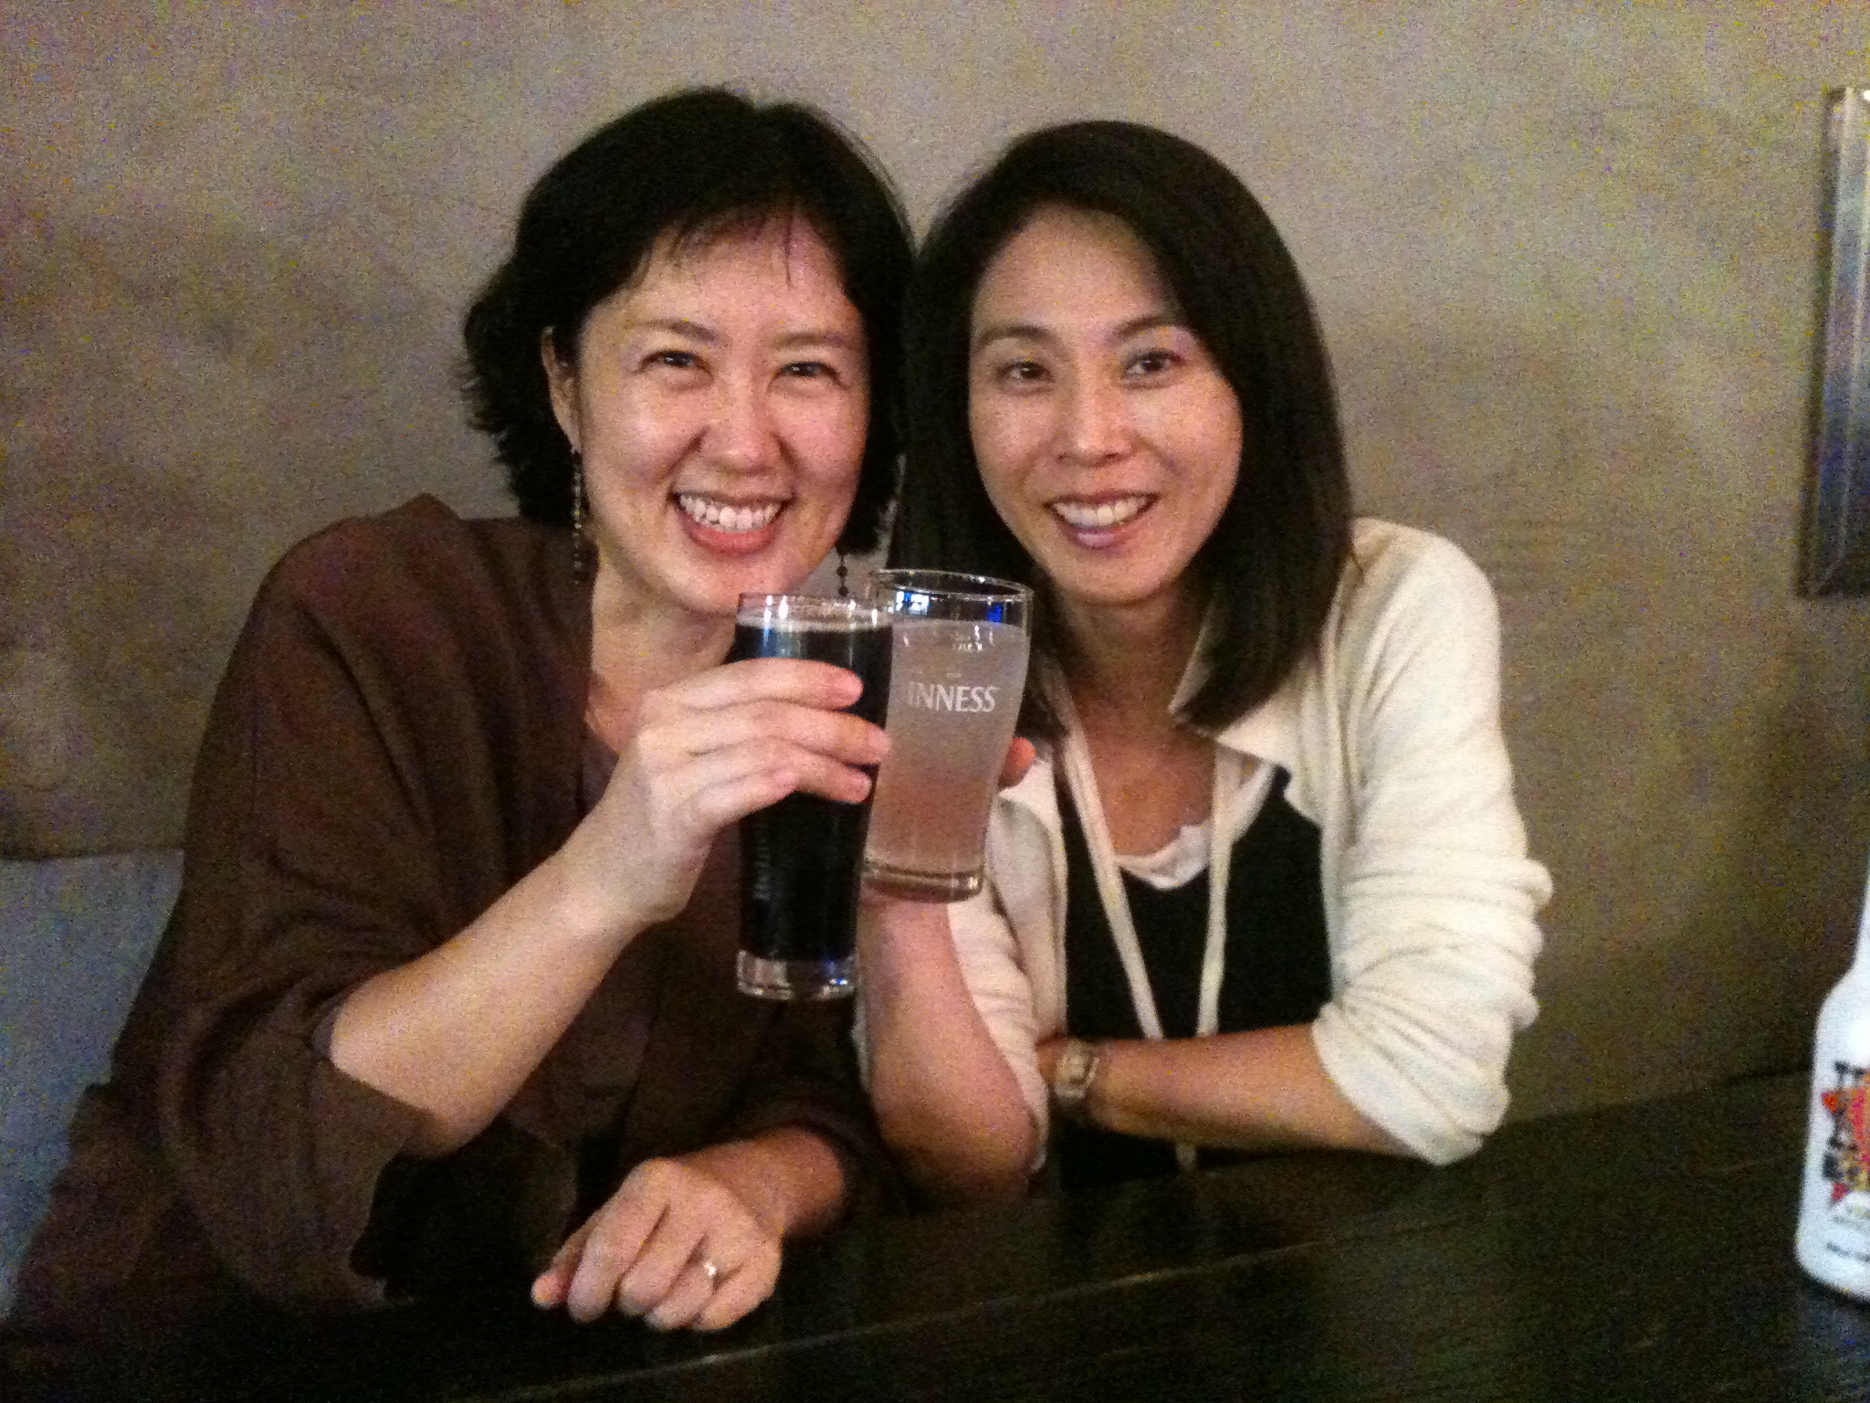

Slide 16
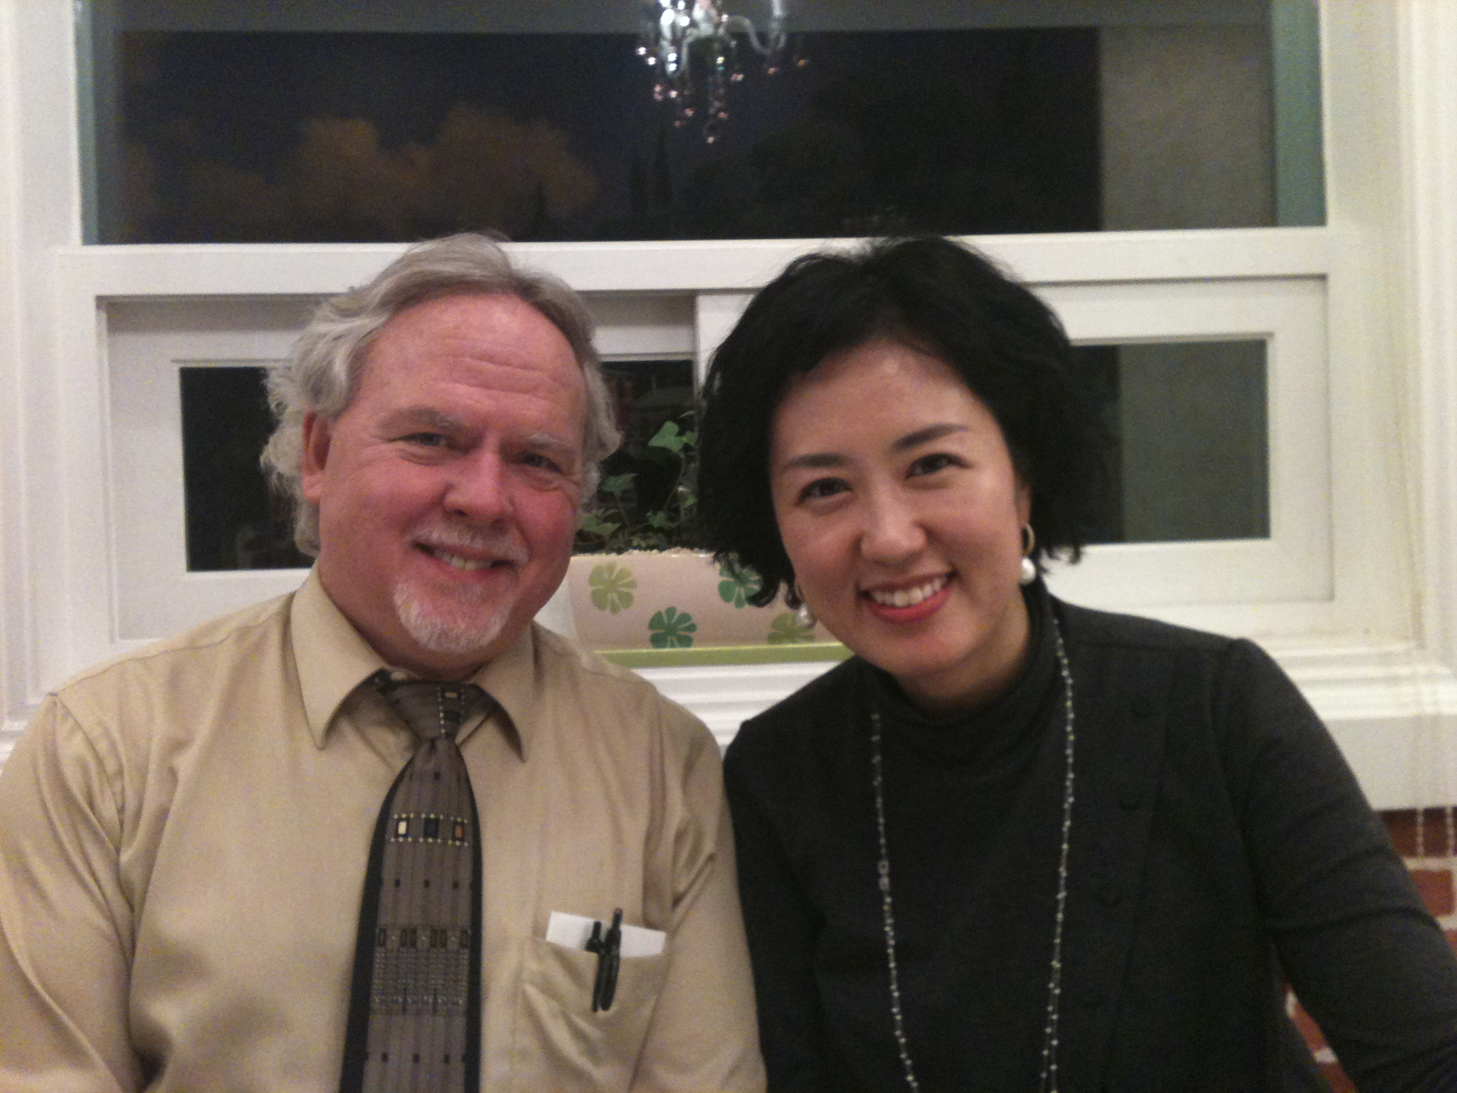

Slide 18
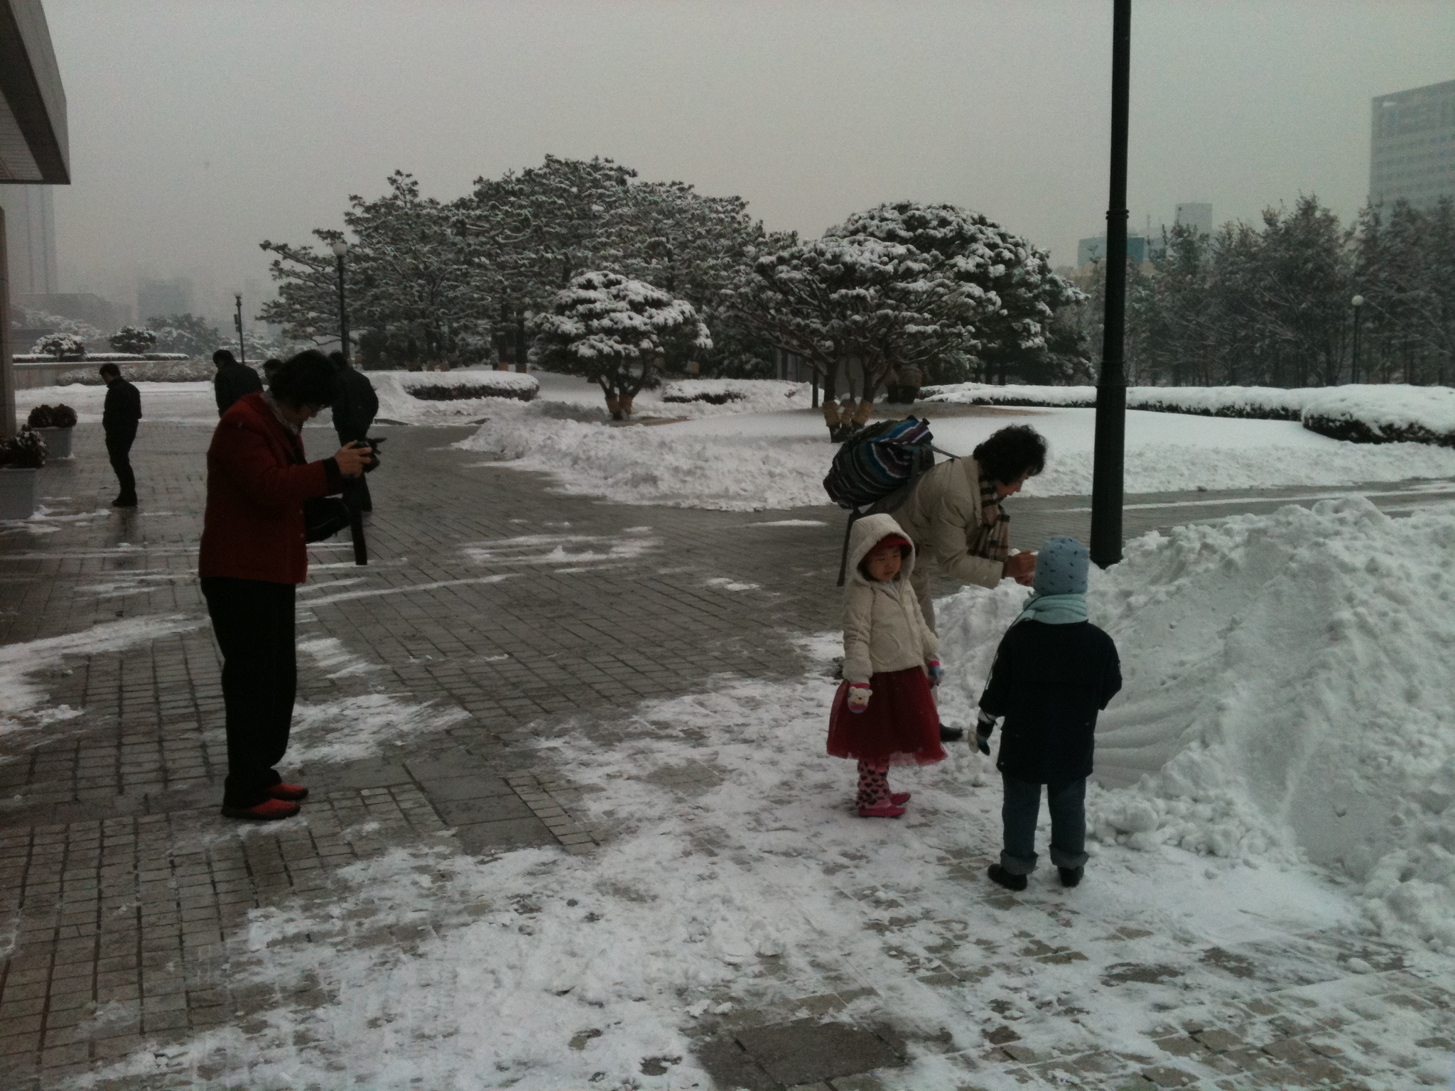

Slide 21
Tell me, and I forget
Show me, and I remember
Involve me, and I understand.

Slide 23
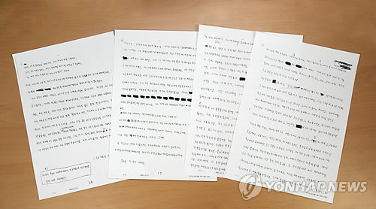

Slide 25
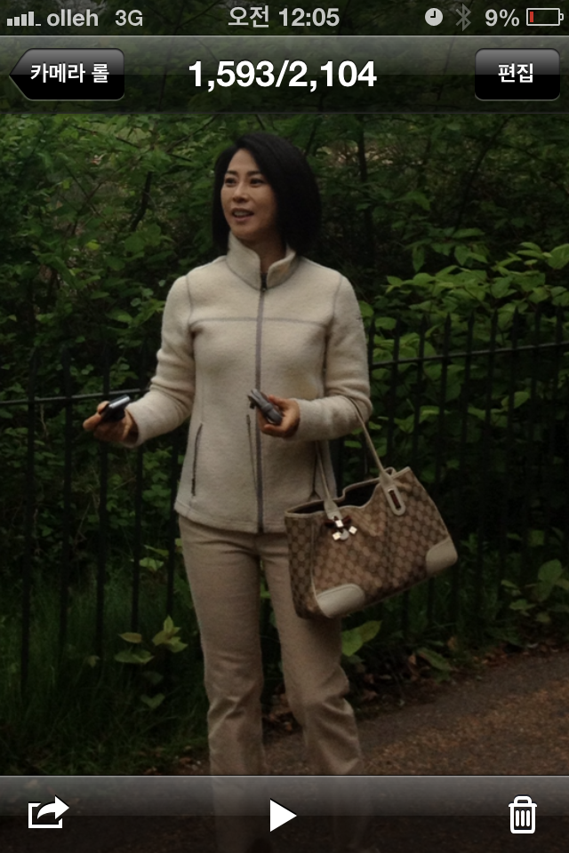

Slide 30
IV. Tele-School Mental Health
Development of System and Manualized
On-line System Consultation, Case Consultation
Training & Education for Human Resources in school
Managing Off-line Mental Health Service with Professionals
When neccessary, Building fast-track to the mental health professionals
상담자 Pool 집적 및 연수 실시
System for Tele-School Mental Health
Manual with Frequently Asked Questions
Easily Access system for psychiatrists who understand school
Sharing difficulties and trials & errors with others

Slide 31
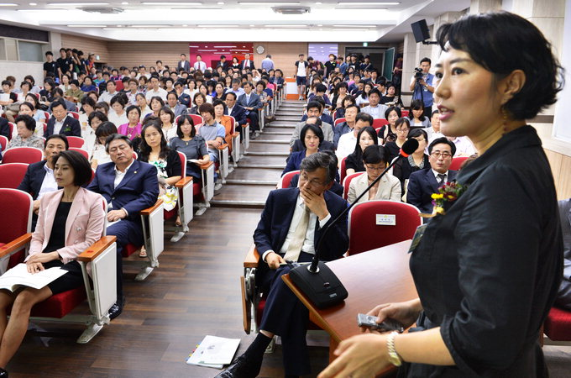

Slide 33
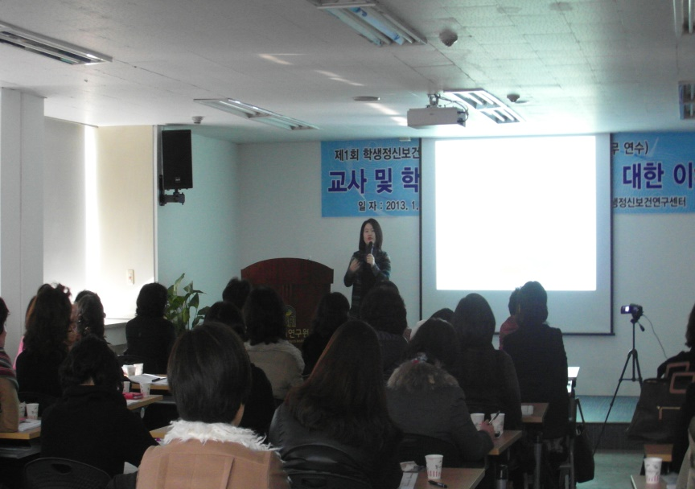
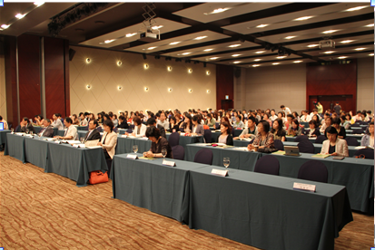
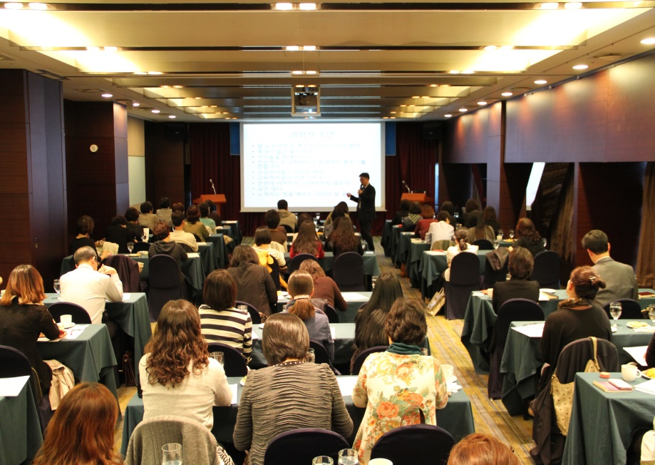
Educational Program for School Nurses & Counselors
Evaluation of Participants
Average 4.3/5 points
* Improvements in understanding
Problematic Behaviors of Students

Slide 34
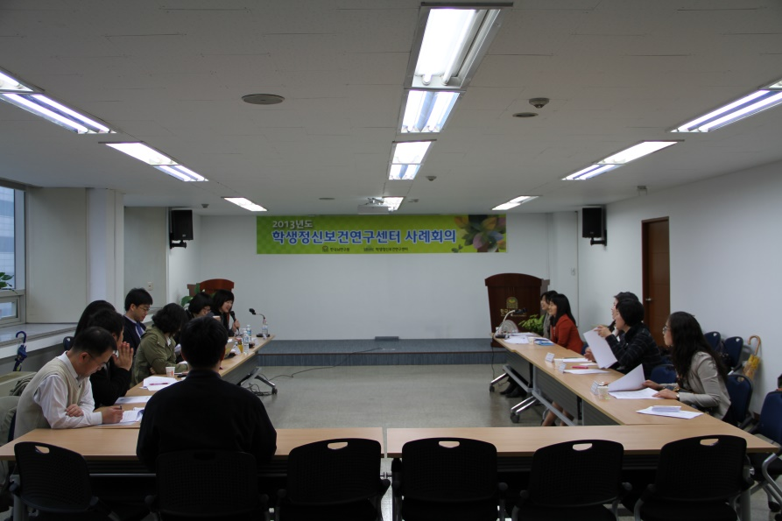
Case Conference for School Nurses & Counselors
Evaluation of Participants in Satisfaction
4.4/5 points

Slide 35
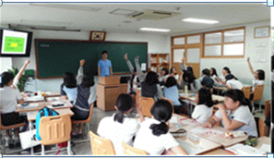
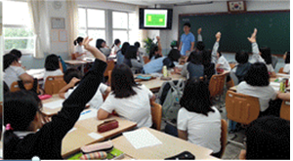
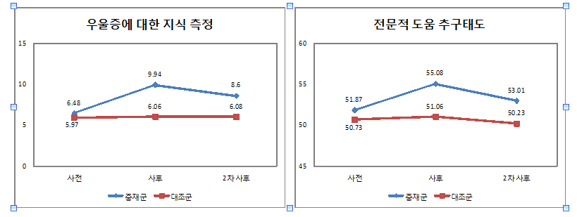
<What’s done in 2013
- developing programs
School-Based Knowledge Improvement Program
(‘Jumping Blue’)
208 Middle School Students , 3 sessions for 2 weeks
Research in Effectiveness
Knowledge about Depression
Asking help for Professionals
Before Edu, After Edu, 2mon later
Before Edu, After Edu, 2mon later
Edu group
Control
Edu group
Control

Slide 36
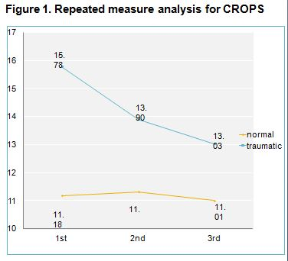
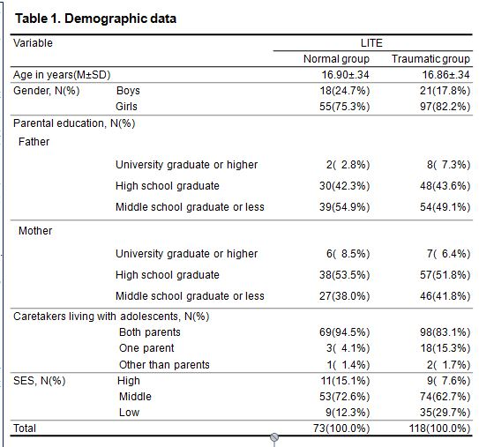
Traumatic Group : N=118
Normal Group : N=73

Slide 37
<What’s done in 2013
Developing Educational Content for teachers, Parents, Studetens>
Reflets for Parents about Teens’ Brain
Informational Handouts about School Mental Health

Slide 38
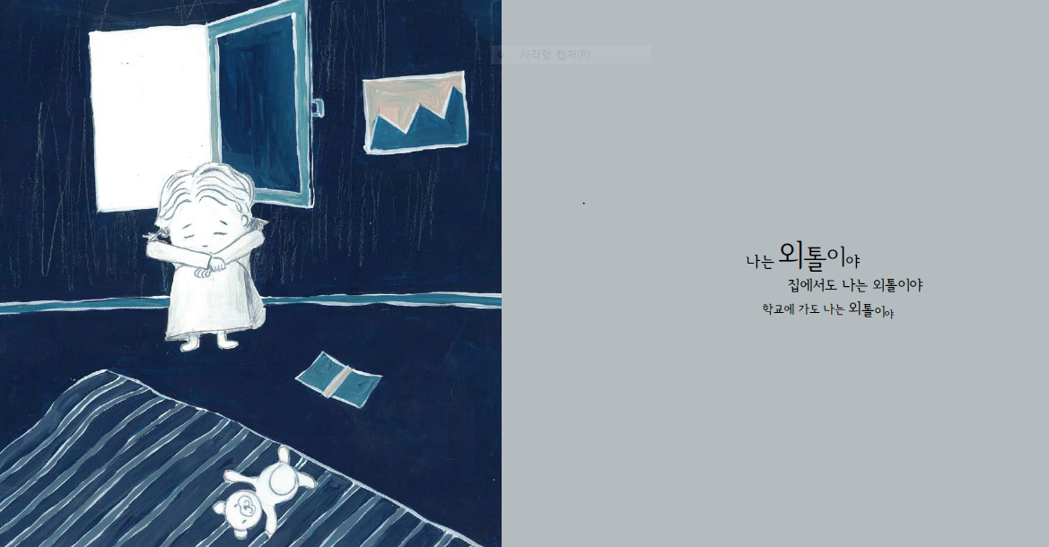

Slide 39
Flow chart of Postvention of School Crisis
Happening of School Crisis
: Death of Students or Teachers
Together with Community
Gathering of Fact
Organizing Crisis Response Team
: Let the School Staff Know
Briefing to
Math Media/Students/Parents
Helping
the Greif Reaction of Students
Professional Counseling Support
for High Risky Students
Professional Support
for Parents Group
/Students Group
Long-term & Additional Support
Recovery of New Normal Routine Activity and Function of School

Slide 40
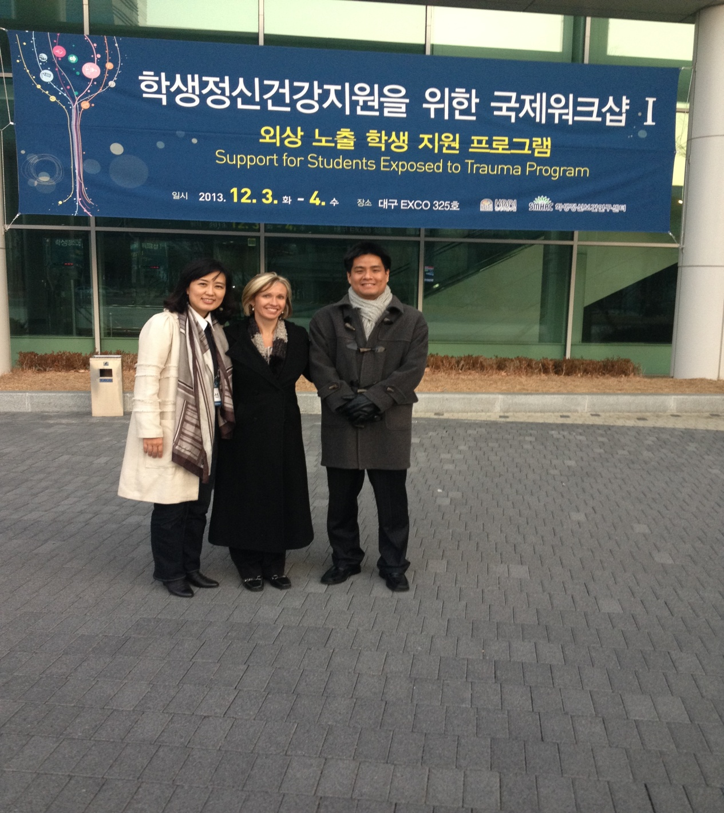

Slide 41
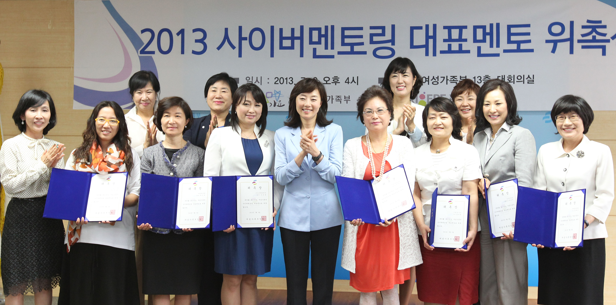

Slide 42
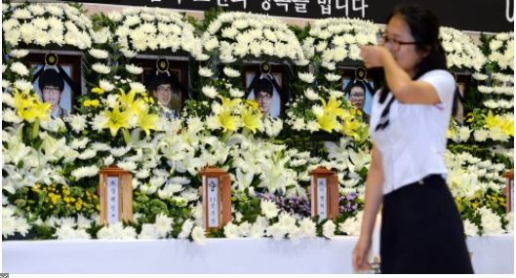
Gonju National High School Boot Camp
- 5 Students Died, 2013, July 17th.

Slide 43
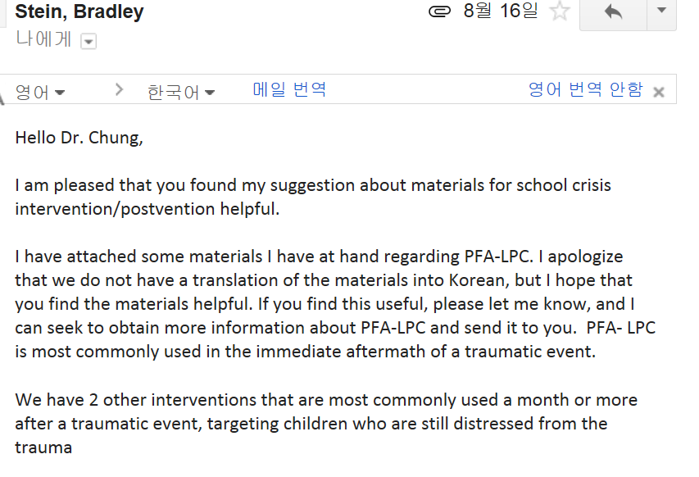

Slide 44
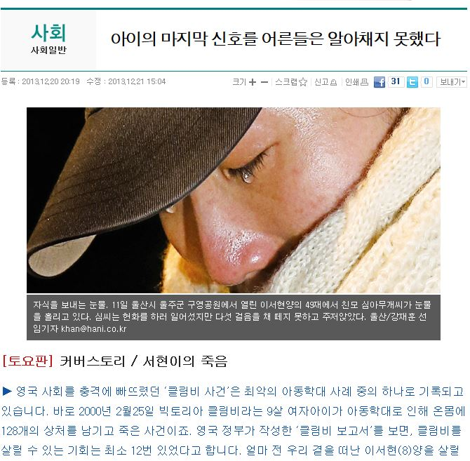

Slide 46
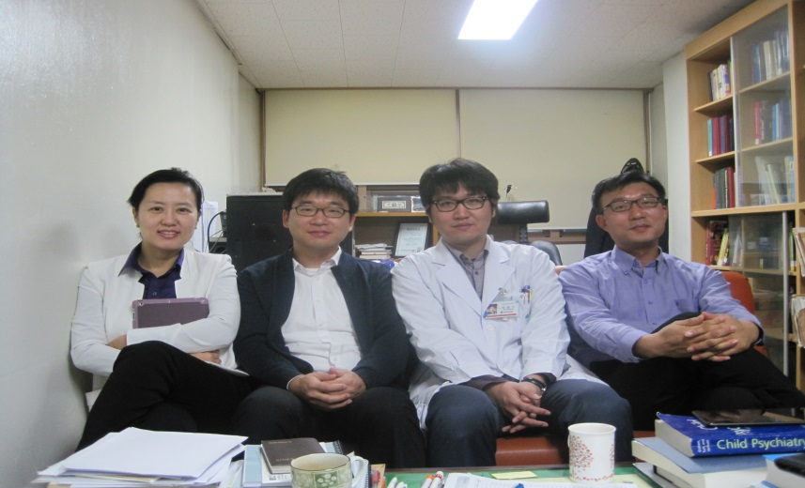
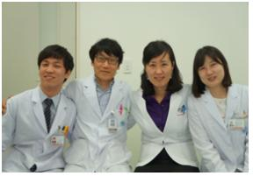

Slide 47
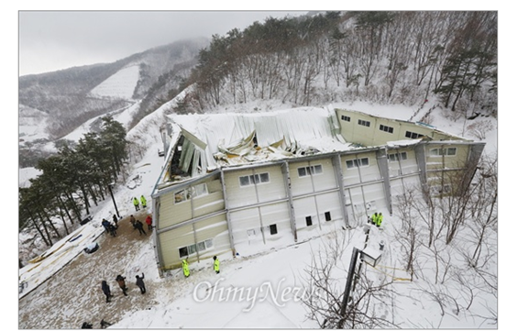
<Postvention of
Busan University
Of Foreign Affairs>
2014, Feb. 17th
Kyungjoo City, Mauna Resort,
Collapse of Roof of Gymnasium,
9 Students Died
550 Students in the building & 550 in the Resort
Psychological First Aid,
Screening
Education about Traumatic Greif
Counseling & Trauma-Focused CBT
For Professors, Students, School Staff

Slide 48
경주 리조트 붕괴 때 다리를 다쳤던 부산외대 이지향양(18·중국학부1·오른쪽)이 부산시 배정이(52) 재난심리지원센터장과 상담하고 있다. 이양은 “지금도 작은 소리에 깜짝 놀라곤 한다”고 말했다. [송봉근 기자]

Slide 49
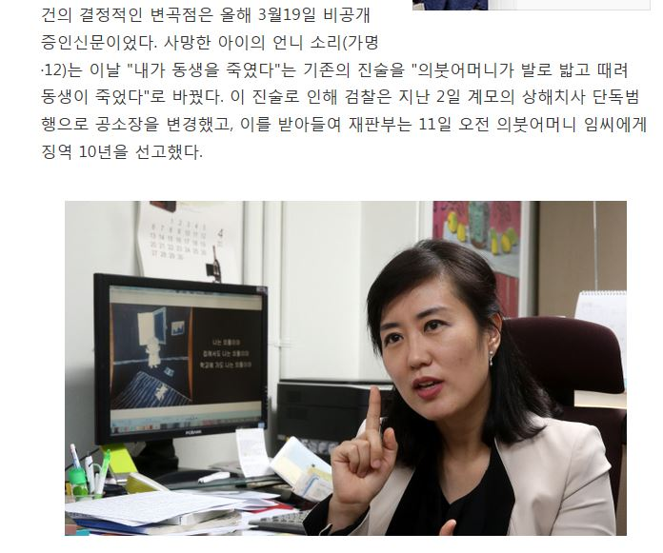

Slide 50
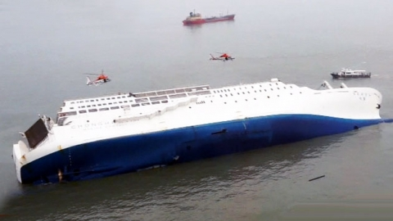
2014, April, 16^{th,} ‘Sewel Boat’ Sinking Tragedy
300 People Died
(including 250 Danwon High School Students & Teachers
on School trip
to Jeju Island)
3 mental health proffesionals went to the Port
3 went to the Danwon High School
on Accident day.
Starting giving ‘Psychological First Aid’, Control of Access

Slide 51
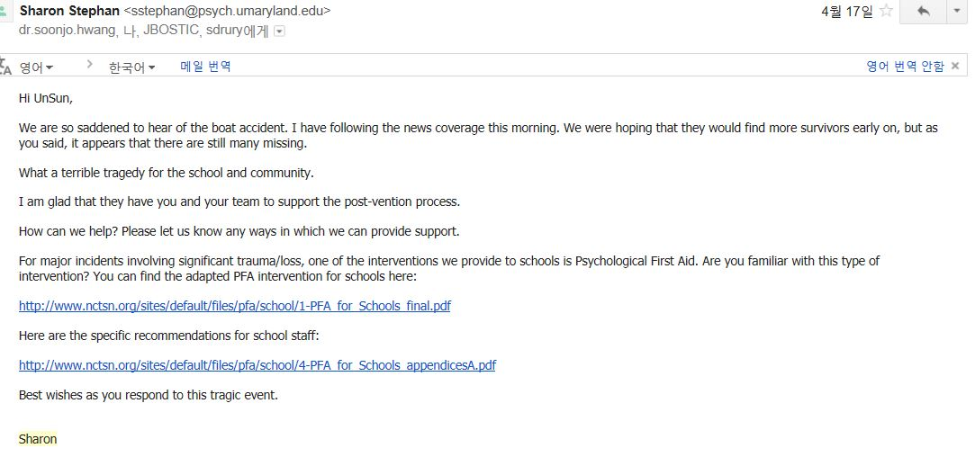

Slide 52
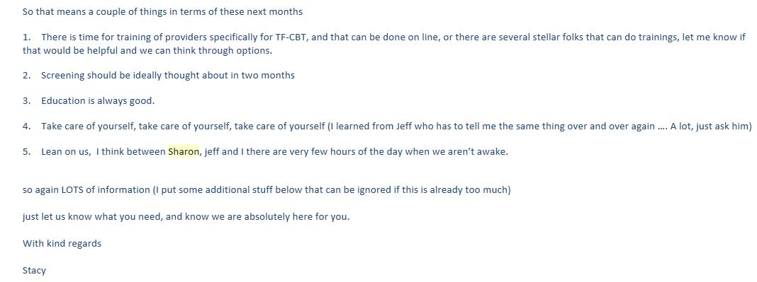
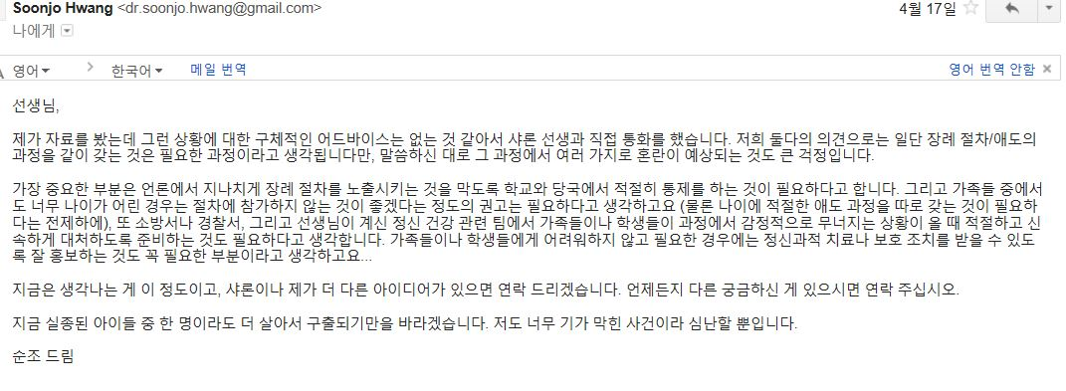

Slide 53
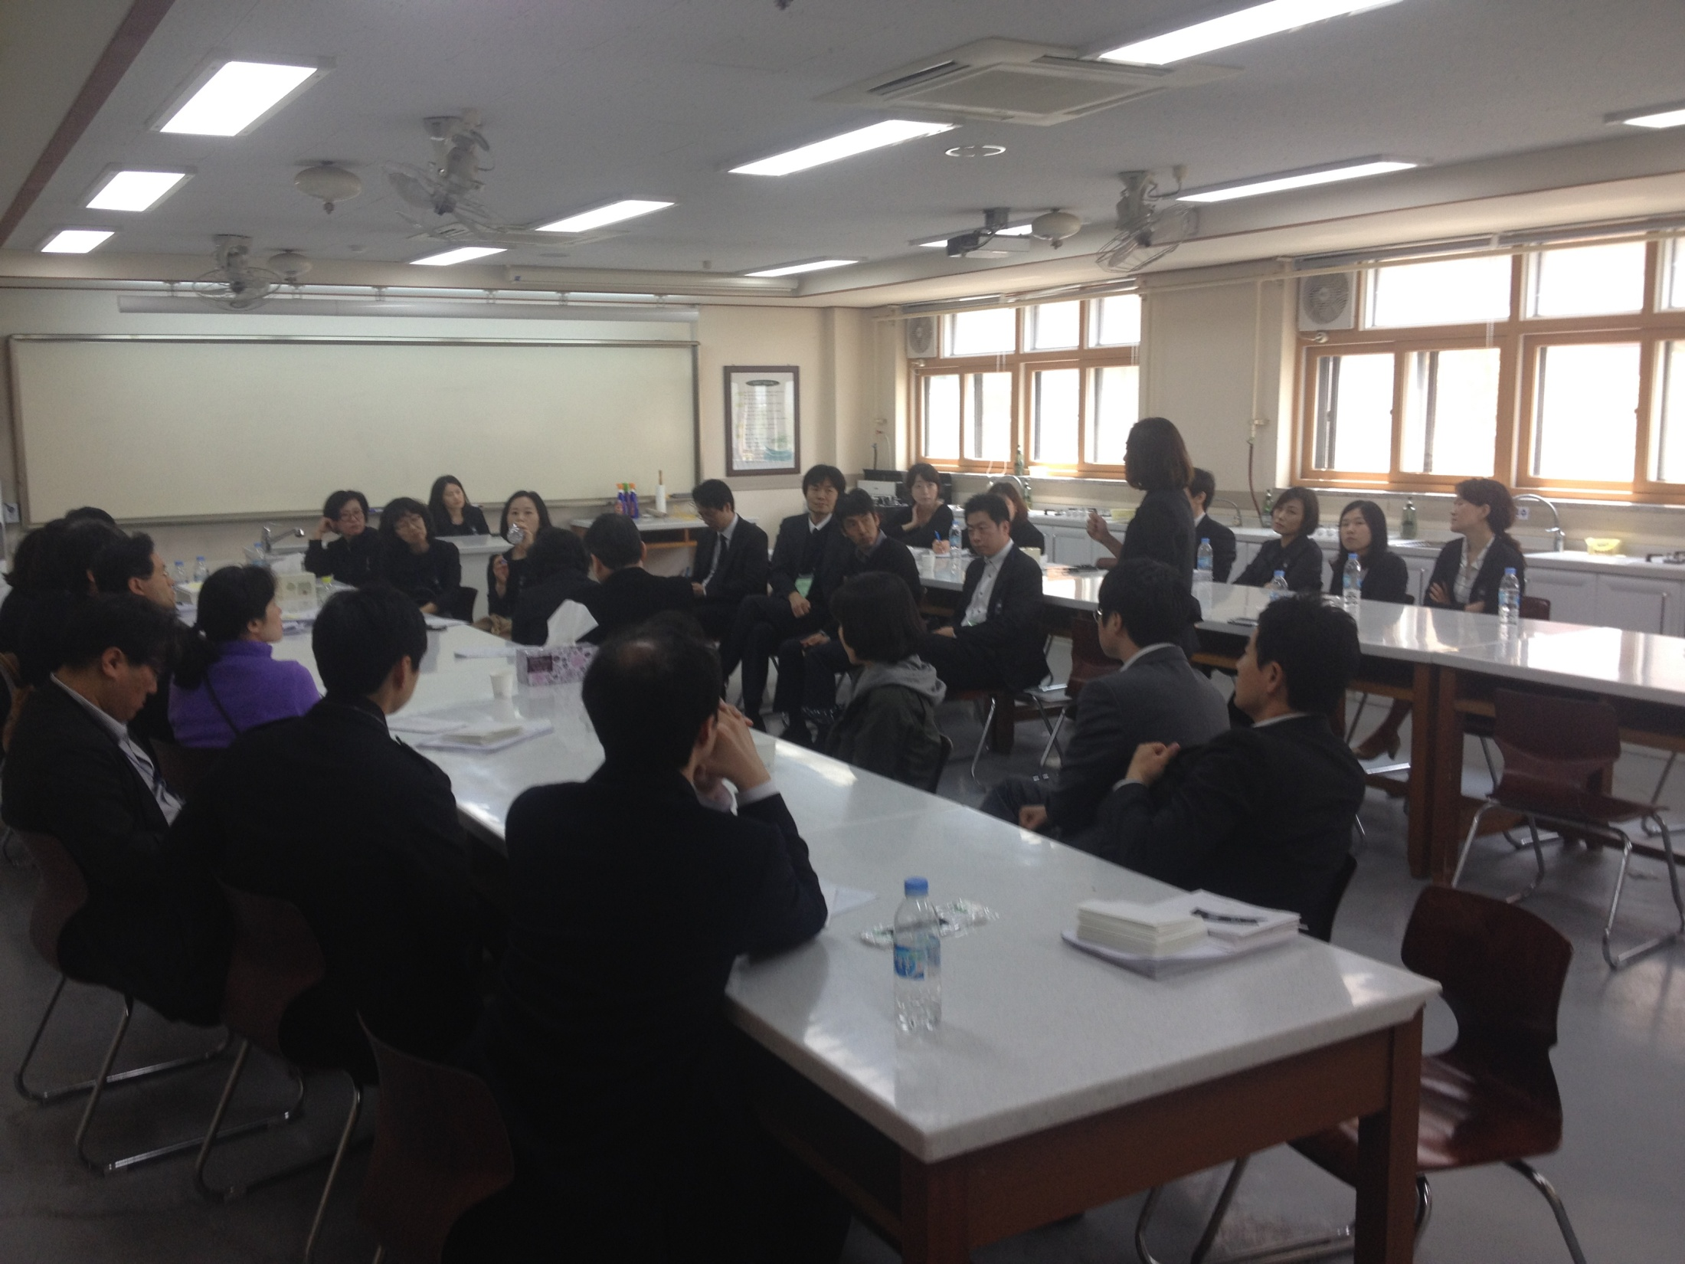

Slide 54
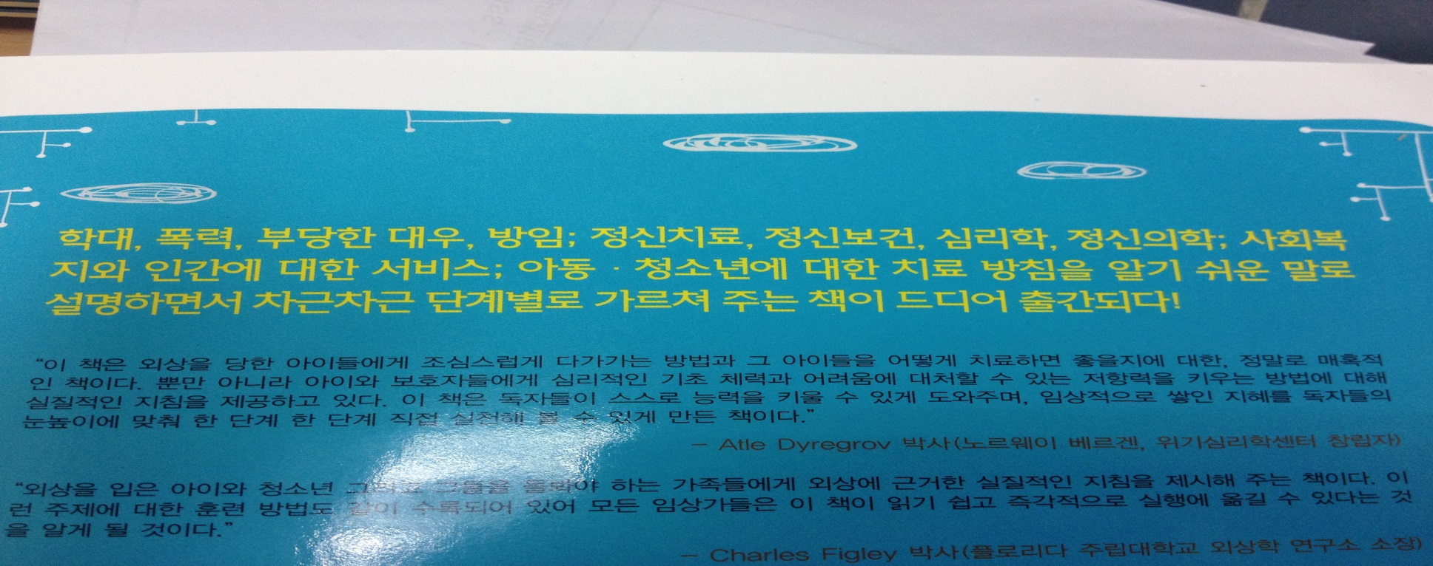

Slide 55
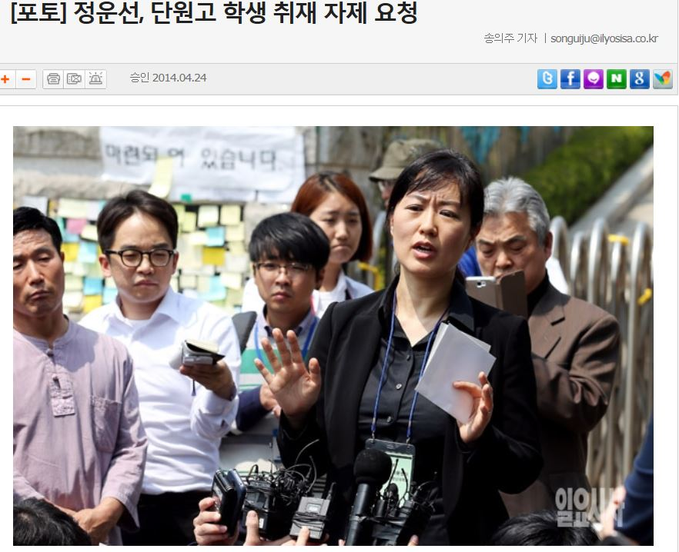

Slide 56
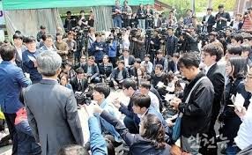
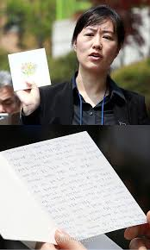
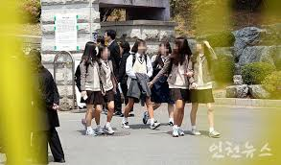

Slide 57
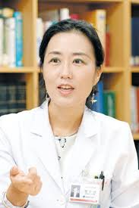
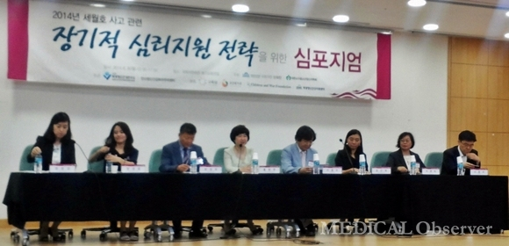

Slide 59
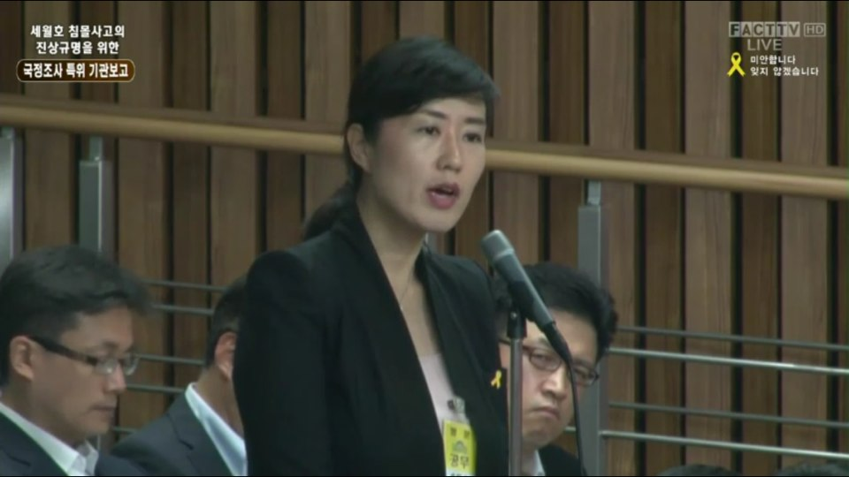

Slide 62
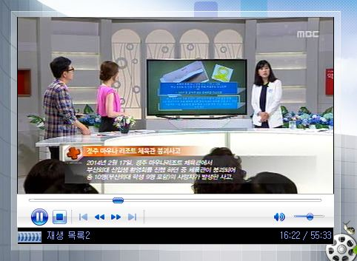

Slide 63
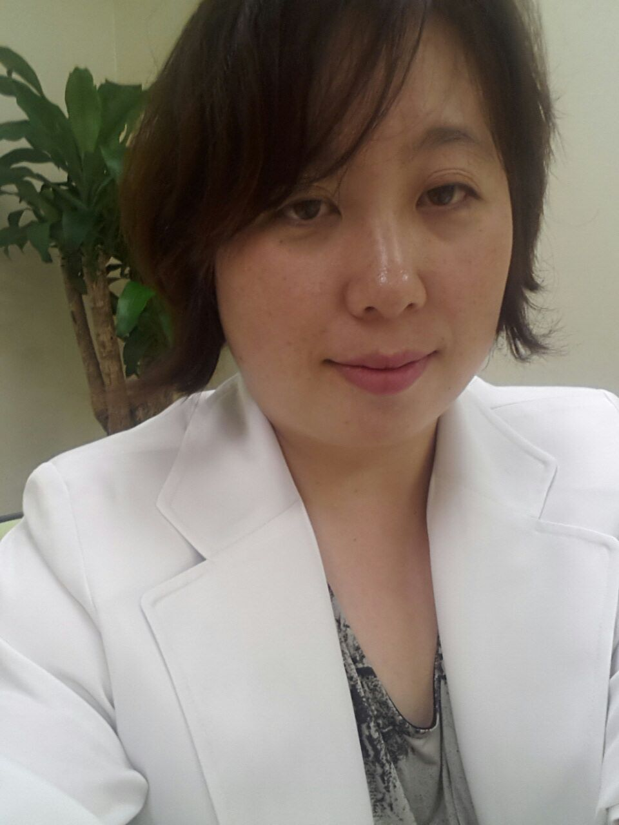

Slide 64
National Institute of Mental Health(NIMH) 공동 연구
Investigating the impact of fluoxetine treatment on BOLD response in trauma-exposed patients with Conduct Disorder and Oppositional Defiant Disorder and the relationship of this impact with symptom improvement
Principal Investigator : Un-Sun Chung, M.D., Ph.D
Adjunct Principal Investigator : James Blair, Ph.D.
Lead Associate Investigator : Soonjo Hwang, M.D.

Slide 66
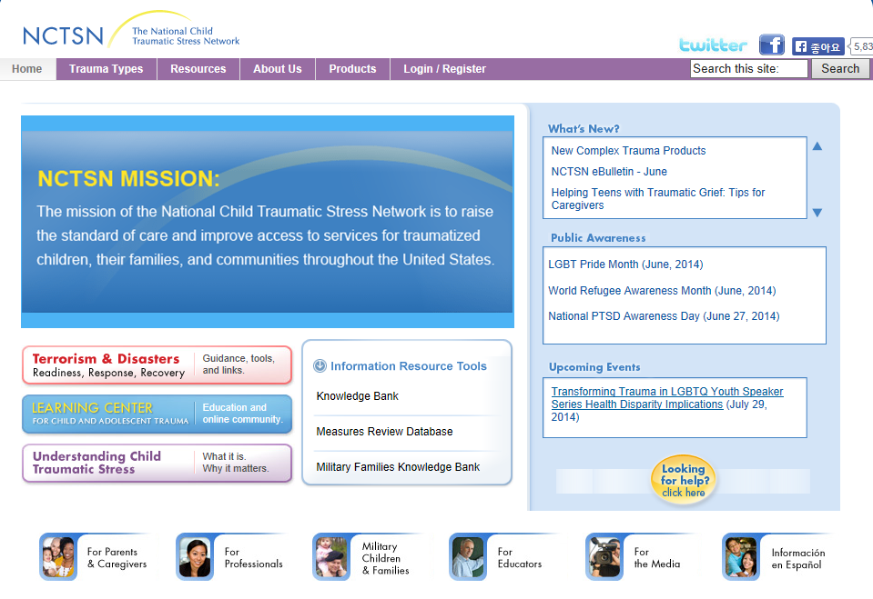

Slide 67
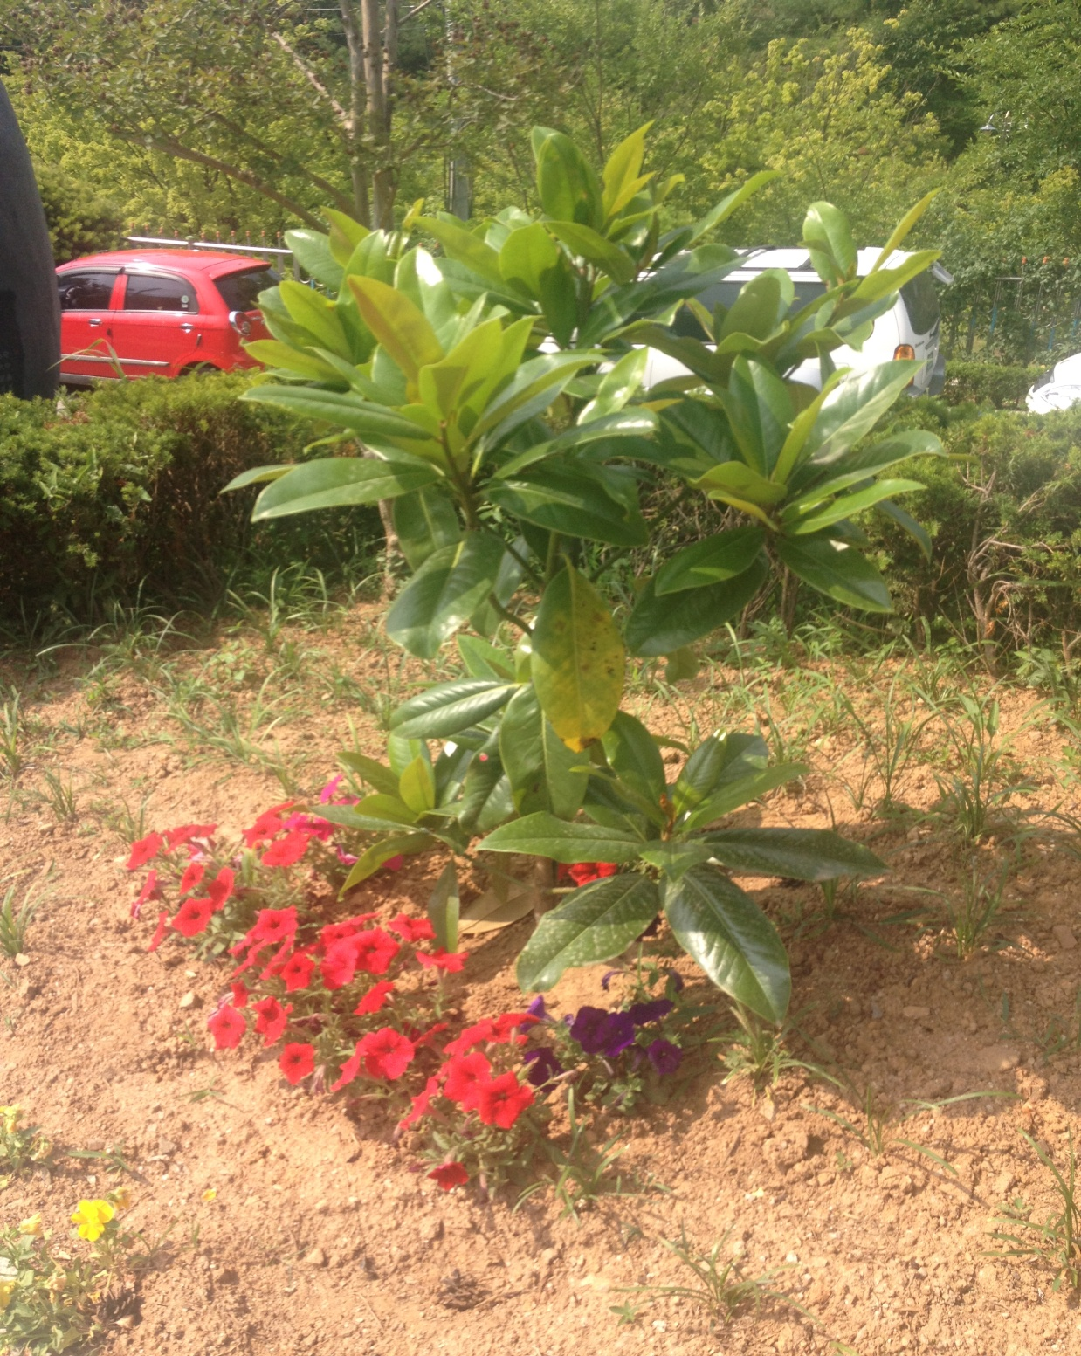

Slide 68
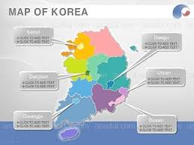

Slide 69
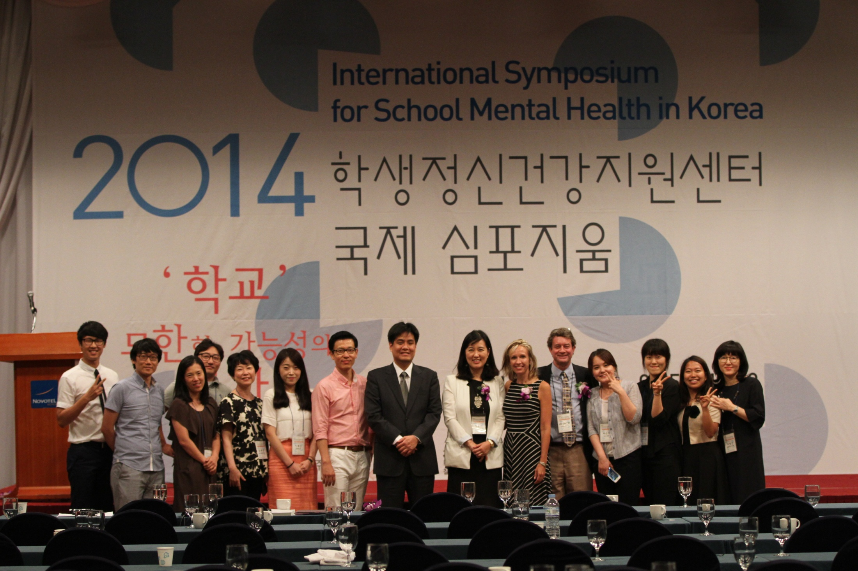
’School’,
The Space
for the limitless Possibility

Slide 71
Thank you for your attention

Slide 72
