Slide 1
LGBTQ Youth in Foster Care
Kirsten Simonton, MD
Cincinnati Children’s Hospital Medical Center
Academy on Violence and Abuse Conference
10-17-2014

Slide 2
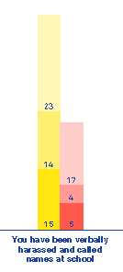
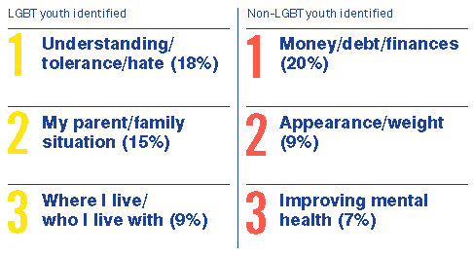
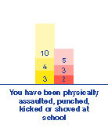

LGBTQ Youth in America
The Health of Lesbian, Gay, Bisexual, and Transgender People:
Lesbian, Gay, Bisexual, Transgender, and Questioning
  Pansexual, Intersex, Asexual, Transexual, Gender-queer, Two Spirit … gender nonconforming or gender dysphoric
IOM Report 2011
HRC: Growing Up LGBT in America (2013)
Institute of Medicine, Committee on Lesbian Gay Bisexual and Transgender Health. The Health of Lesbian, Gay, Bisexual, and Transgender People. Washington, DC: National Academies Press; 2011

Slide 3
LGBTQ Youth in Foster Care
Adoption and Safe Families Act (ASFA) of 1997
  Assure permanency, safety and well-being of youth in foster care
LGBTQ youth left out
  Adolescent & group homes (congregate care)
  Unique reasons for entering care
  Discrimination, violence, harassment
  Multiple placements, run-aways, aging out
Disproportionately represented in out-of-home care
  Juvenile justice system
  Homeless population
Jacobs & Freundlich. Achieving Permanency for LGBTQ Youth. Child Welfare League of America 2006; Vol. LXXXV, #2

Slide 4
The Hypotheses:
LGBTQ youth are overrepresented in foster care as compared to the general population.
Youth in foster care who self-identify as LGBTQ experience poorer outcomes as compared to non-LGBTQ youth.
Placements
Group Homes
Hospitalizations
Homeless
Treated Well
The Williams Institute. Sexual and Gender Minority Youth in Foster Care. Los Angeles Foster Youth Study; August 2014.

Slide 5

CHECK Foster Care Clinic
Comprehensive Health Evaluations for Cincinnati’s Kids
Initial placement, 30-days, change of placements
SW evaluation at 30-day visit:
  Screen youth > 6yo
    Gender identity question
  Screen youth > 12yo
    Additional sexual attraction question
LGBTQ & non-LGBTQ cohorts

Slide 6
Screening Tool:
All children > 6yo ask the following:
  FIRST VISIT: “Your record says you are {female/girl or male/boy}, do you consider yourself {female/girl or male/boy} or something different?”
  FOLLOW UP VISIT: “At your last visit you identified as {female/girl or male/boy}, has there been any change since that time?”
All children > 12yo ALSO ask the following:
  FIRST VISIT: “Are you attracted to males/boys, females/girls, both, neither or not sure yet?”
  FOLLOW UP VISIT: “At your last visit you reported you were attracted to {males/boys or females/girls or both males & females or neither males or females or you weren’t sure yet}, has there been any change since that time?”
Validity – no gold standard
Reliability – “fluidity” in both gender and sexual identity

Slide 7

Prevalence Data
6 months of study (Feb – Aug 2014) → 200 youth
  > 13yo: 16 LGBTQ/98 total teens = 16% LGBTQ
  Transgender youth: 2 teens
General population data:
  CDC: Gay/lesbian or bisexual = 5%; with “not sure” = 7.5%
  Add Health Study: 7.4% males and 5.3% females
  Gallup poll (2012): 3.4%
  USDHHS Survey (2013): 1.6% gay/lesbian, 0.7% bisexual

Slide 8
Second Aim: Characterization
Is there a unique profile to LGBTQ youth in foster care?
Measures routinely collected in clinic:
Data collection by chart review
Describe the LGBTQ & non-LGBTQ youth in foster care
  Trauma symptoms
  Suicidal ideation
  Parenting Stress Index
  STIs
  Psychotropic medications
  Psychiatric diagnoses
  Psychiatric admissions
  Chronic medical conditions
  BMI
  Substance abuse
  Safety
  Bullying

Slide 9

Implications & Challenges
Implications:
  Identify the scope of this issue
  Is there a unique profile to LGBTQ youth in foster care?
  What clinical factors should we be monitoring?
  Why it is important to identify this youth at the time of placement?
  How can we best educate foster families?
Challenges:
  Consent – CPS & IRB
  Comfort in addressing gender & sexual identity in youth
  Sensitive questioning during a traumatic period

Slide 10
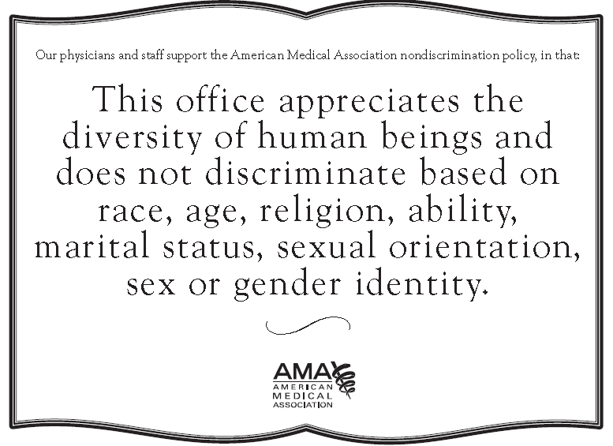


Changing Our Clinical Practice
  Asking gender & sexual identity questions
  Preferred name
  Systematic questions – substance use, bullying, safety
  Resources brochure
  Nondiscrimination notices

Slide 11
References:
Institute of Medicine, Committee on Lesbian Gay Bisexual and Transgender Health. The Health of Lesbian, Gay, Bisexual, and Transgender People. Washington, DC: National Academies Press; 2011
Jacobs & Freundlich. Achieving Permanency for LGBTQ Youth. Child Welfare League of America 2006; Vol. LXXXV, #2
Gates, G. J., & Newport, F. (2012). Special report: 3.4% of US adults identify as LGBT. Gallup, Inc
Kann, L., O’Malley Olsen, E., McManus, T., Kinchen, S., Chyen, D., Harris, W., & Wechsler, H. (2011). Sexual identity, sex of sexual contacts, and health-risk behaviors among students in grades 9–12: Youth Risk Behavior Surveillance, selected sites, United States, 2001–2009. Mortality and Morbidity Weekly Report (MMWR), 60(SS07), 1-133.
The Williams Institute. Sexual and Gender Minority Youth in Foster Care. Los Angeles Foster Youth Study; August 2014.
Human Rights Campaign. (2012b). Growing up LGBT in America: At home, at school, and in the community. Washington, DC: Author. Retrieved from http://www.hrc.org/files/assets/resources/Growing-Up-LGBT-in-America_Report.pdf
Harris, Kathleen Mullan, and J. Richard Udry. National Longitudinal Study of Adolescent Health (Add Health), 1994-2008. ICPSR21600-v15. Chapel Hill, NC: Carolina Population Center, University of North Carolina-Chapel Hill/Ann Arbor, MI
National Center for Health Statistics. The National Health Interview Survey, questionnaires, datasets, and related documentation: 1997 to the Present. Hyattsville MD: USDHHS, 2009. Retrieved from http://www.cdc.gov/nchs/nhis/quest_data_related_1997_forward.htm

