Slide 1
Trauma Informed Healthcare and Communities
Tasneem Ismailji MD, MPH
Academy on Violence and Abuse
Board Chair

Slide 2
Definition of Trauma (SAMSHA)
Individual trauma results from an event, series of events, or a set of circumstances that is experienced by an individual as physically or emotionally harmful or threatening and that has lasting adverse effects on the individual’s functioning and physical, social, emotional, or spiritual well-being

Slide 3
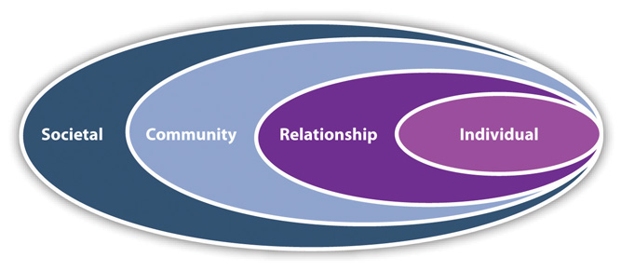
Public Health Prevention
Social Ecological Model
http://www.cdc.gov/violenceprevention/overview/social-ecologicalmodel.html
Notes:
This is the Public Health Framework for prevention-
Individual-biological and ecological factors that increase the likelihood of becoming a survivor or perpetrator
Relationships- close social circle of peers, partners, family
Community- settings ,schools, workplaces, healthcare facilities, neighborhoods
Societal-broad factors that help create an environment that encourages or discourages violence.
We are seeing an increase in social inequalities

Slide 4
Principles of Trauma-Informed Care
A trauma-informed approach integrates the following key elements:
Realizing the prevalence of trauma exposure >60% of men and >50% of women
Recognizing how trauma affects individuals, families, and communities
responding to this knowledge

Slide 5
Principles of Trauma-Informed Care
The core principles of trauma-informed care are:
Safety
Trustworthiness
Choice
Collaboration
Empowerment
Such principles can be infused into all areas of clinical practice and environment
Notes:
A trauma-informed approach alludes to how a primary care practice contemplates and responds to those who have or are experiencing trauma.

Slide 6
Principles of Trauma-Informed Care
Assess and strengthen protective factors
Complex trauma and its effects are often unrecognized, misdiagnosed and misaddressed
People impacted with trauma present to multiple services, care is fragmented, poor follow up
And this can lead to retraumatization

Slide 7
Types of Trauma
Interpersonal violence –abuse, rape, DV, violent crime, gangs, bullying
Social violence – war, terrorism, disasters
Chronic social stressors – racism, poverty, humiliation

Slide 8
Types of Trauma
Cultural dislocation
Institutional (or “sanctuary”) trauma
Organizational trauma
Historical trauma

Slide 9
A Few Current Concepts
Adverse Childhood Experiences (ACEs)studies
EcoBioDevelopmental Framework ( American Academy of Pediatrics)
Epigenetics- how environment affects the regulation of our genome
Parenting and Attachment Theory
Medical Home for Children Exposed to Violence ( American Academy of Pediatrics)

Slide 10
EcoBioDevelopmental Framework
Important new concept by the American Academy of Pediatrics
See graph at
Reference: Schonkoff JP, Garner AS 2012 Pediatrics 129;e232

Slide 11
Epigenetics

Slide 12
Epigenetics
There are distinct epigenetic differences in adults with PTSD who have childhood adverse events and those who do not
Reference:
Proc Natl Acad Sci U S A. 2013 May 14;110(20):8302-7. doi: 10.1073/pnas.1217750110. Epub 2013 Apr 29.
Childhood maltreatment is associated with distinct genomic and epigenetic profiles in posttraumatic stress disorder.
Mehta D¹, Klengel T, Conneely KN, Smith AK, Altmann A, Pace TW, Rex-Haffner M, Loeschner A, Gonik M, Mercer KB, Bradley B, Müller-Myhsok B, Ressler KJ, Binder EB.
Notes:
And can be passed down to the next generation

Slide 13
Toxic Stress
“Excessive or prolonged activation of the physiologic stress response system in the absence of the buffering protection afforded by stable responsive relationships”

Slide 14
Brain and Stress
Important graphic- please see
Stress and Allostasis- Induced Brain Plasticity
Bruce S McEwen and Peter J Gianaros
Annual Review of Medicine Vol 62(2011) 431-4445

Slide 15
Parenting and Attachment
Four major patterns of attachment
Secure (Type B)
Anxious – avoidant (Type A)
Anxious-resistant (Type C)
Disorientated- disorganized (Type D)- this is the type of attachment of most concern and associated with child maltreatment
http://www.avahealth.org/videos/putnam_intergenerational.html
Notes:
Healthy attachment is critical to the regulation of emotional experience
Type D infants have disorganized behavior, HPA axis is activated, cortisol is neurotoxic
Mom was frightened or her behavior was frightening to baby, disruptive affective maternal communication.
Interventtions– Home visitation Parental Enhancement for Maternal Depression (PEMD)

Slide 16
Parenting and Attachment
With a trauma informed approach, healthcare team can:
Educate parents about the health effects of ACEs
Create an emotionally safe and nonjudgmental space for parents to talk about their own ACEs
Recognize that parenting may trigger their own traumatic experiences
Identify families strengths
Provide resources and skills for supportive parenting

Slide 17
Medical Home for Children and Families Exposed to Violence and Abuse
Identify the population and track them
Assess the family and patients strengths/assets and need for specific services
Make referrals
Provide self management tools
Follow up and continuity of care

Slide 18
Resilience
Resilience is the process of adapting well in the face of adversity, trauma, tragedy, threats, or significant sources of stress, such as family and relationship problems, serious health problems or workplace and financial stressors. It means “bouncing back” from difficult experiences
The Road to Resilience www.apa.org

Slide 19
Tarpon Springs, Florida
First trauma informed community
Small scenic gulf coast community ~24,000
http://www.peace4tarpon.org

Slide 20
BUILD YOUR COMMUNITY RADAR
R- REFLECT
A- ASSESS
D- DECIDE
A- ACT
R- REFINE
AND MAY THE FORCE BE WITH YOU!

Slide 22
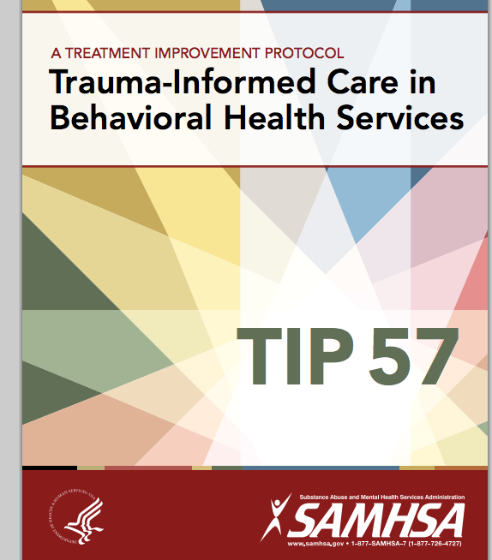

Slide 23
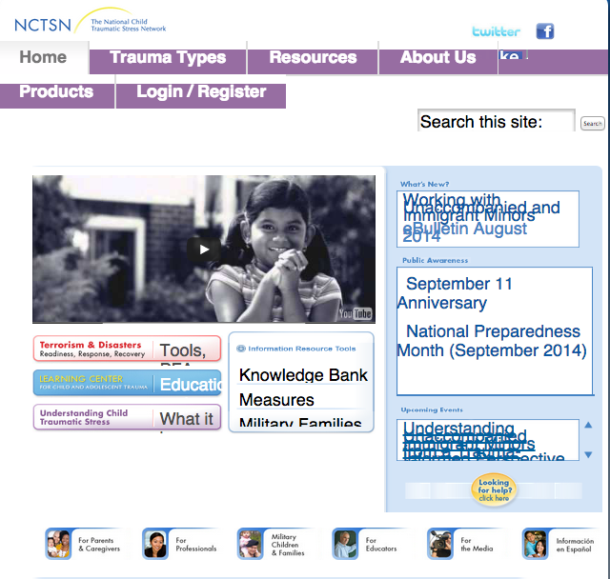

Slide 24
Resources
Academy on Violence and Abuse (AVA)
www.avahealth.org
Substance Abuse and Mental Health Services Administration (SAMHSA) TIP 57
National Center for Trauma Informed Care
National Child Traumatic Stress Network (NCTSN)
www.nctsn.org

Slide 25
Resources
American Academy of Pediatrics Medical Home for Children and Adolescents Exposed to Violence
www.aap.org
American Academy of Pediatrics- plans for a Center on Healthy Resilient Children to be headed by Dr Bob Block past AVA & AAP President
Acestoohigh.com

